Slide 1
Core Workshop IV
Logistic Regression
10675461 Yi Lu
Notes:
Good afternoon, welcome to MUDSS Core Workshop Five: Introduction to binary classification and logistic regression.

Slide 2
OVERVIEW
Notes:
In today’s workshop, we will start from the real-world use of classification algorithms.
Then we will take a glance at what binary classification is and look at one important classification algorithm: Logistic Regression.

Slide 3




Real-Life Applications
Predicting
Weather
Medical Diagnosis
Text
Editing
And
More…
Notes:
Logistic Regression is useful in every aspect where binary classifiers are capable of solving problems.
For instance, it can predict upcoming weather from several known types base on given meteorological parameters.
What’s more, given the symptoms, we can use Logistic Regression to predict the kind of disease which the patient is suffering from.
Logistic Regression can also be used to process text fragments. Toxic speech detection, topic classification and email sorting are examples where Logistic Regression shows good results.

Slide 4
But what is Classification ?
Notes:
So far, we’ve seen many real-world use where classifiers make great difference to. But what is classification exactly?

Slide 5




Definitions & Principles
Classification
Classification refers to an action which separate different objects into several categories based on their common and unique characteristics.
In machine learning, Classification Algorithm needs to identify new datapoint’s type from a range of known ones, given enough training data and some proper trainings.
Notes:
After extracting the core characteristic of classification problems, we can define ‘classification’ as follows:
it refers to the action which separate different things into several categories based on their characteristics.
In Machine Learning fields, which we are more interested to, a classification algorithm needs to be able to categorize new datapoints based on the given data and proper trainings.
Next, we are going to go over several critical definitions first, then take a close look at what Logistic Regression is, and how it works.

Slide 6
Definitions & Principles
Methodology
Model
Training
Parameter
Optimizing
Classification
Algorithm
An assumption
+
A classification function
A loss function
+
An optimization method
Notes:
Before being introduced to the key definitions in the next slide, we first need to clarify how to understand and analyse a classification algorithm from scratch.
Typically, a classification algorithm consists of two parts: A classification model, and a way to optimize classification function’s parameters.
In more detail, the model usually consists of an assumption of the given data since it’s impossible to model the real situation, and a corresponding classification function which is carefully designed according to the assumption. It takes the datapoint as input and return the result of classification.
Usually, there are many parameters in the classification function which directly affects the performance of our classifier. To find out their optimal values, we need a way to optimize them. This is usually carried out by construct a loss function which reflects “how inaccurate our current classification model is”, then using an optimization method to minimize it.
Therefore, to understand how one classification model work, we need to extract its assumption, understand how its classification function is constructed, see why it has such a loss function, and get familiar with its optimization method on loss function.
In the coming slides, we are going to apply this methodology to take a close look at Logistic Regression.

Slide 7
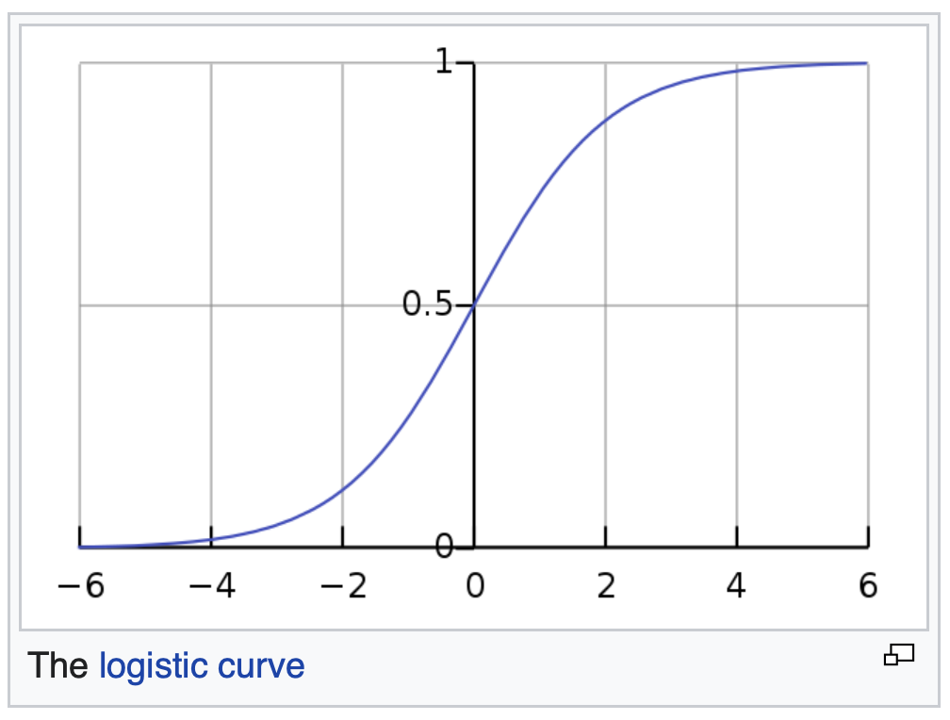


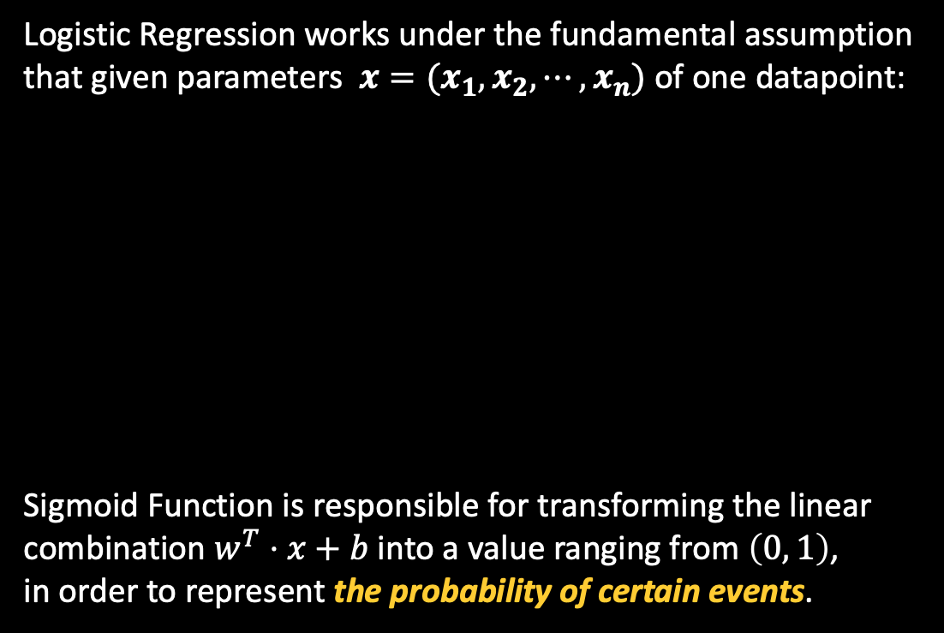
Definitions & Principles
Logistic Regression
Logistic Regression works under the fundamental assumption
that given parameters $x=(x_{1},x_{2},⋯, x_{n})$ of one datapoint:
Sigmoid Function is responsible for transforming the linear
combination $w^{T}⋅x+b$ into a value ranging from $\left(0, 1\right)$,
in order to represent the probability of certain events.
About 0.88
Z=2
Notes:
First, let’s talk about the assumption. In logistic regression, we assume the linear combination of weights $w=(w_{1}, w_{2}, ⋯, w_{n})$ and the bias $b∈ℝ$ reflects a Bernoulli event that this datapoint belongs to one type, which denotes as y=1 or y=0 here.
In case some of you are not familiar with basic probability knowledge,
If one event is a Bernoulli event, it means its probability follows Bernoulli distribution, which will only have two possible outcomes, corresponds to the two possible types in binary classification.
Then is the classification function. In Logistic Regression, we use a specific kind of sigmoid function as its classification function.
In other words, a fully-working Logistic regression model (i.e., the classifier) classifies the datapoints
by calculating $σ(w^{T}⋅x+b)$ and decide which category the given datapoint belongs to according to the computed probability.

Slide 8


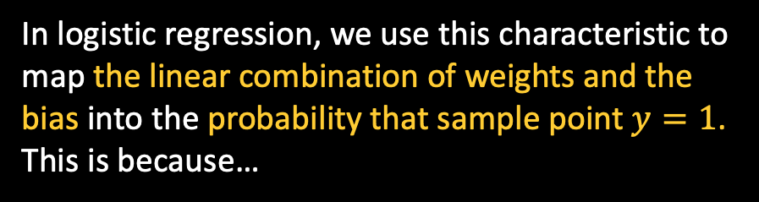
Definitions & Principles
Sigmoid Function
Sigmoid function, also called “Logistic Function”,
which is the inverse of logit functions.
It’s usually denoted as $σ()$.
In logistic regression, we use this characteristic to map the linear combination of weights and the bias into the probability that sample point $y=1$. This is because…
Notes:
So why sigmoid function is chosen? It’s because one of its core characteristics.
Sigmoid function is capable of mapping real numbers in $\left(−∞, ∞\right)$ to values ranging from $\left(0, 1\right)$, which make it a perfect solution for us to convert the linear combination of weights and the bias into the probability value.
Sigmoid Function is also called “Logistic Function” since it’s the inverse of logic functions. So what is “Logit function”?

Slide 9


Definitions & Principles
Odds:
Log-Odds:
Odds are an expression of relative probabilities, which reflects the difference between two possibilities.
The logit is called the log-odds since it is the logarithm of the odds ratio where p is a probability.
Notes:
The so-called “logit function” is the logarithm of the odds-ratio. It maps probability values from $(0, 1)$ to real numbers in $(−∞, ∞)$.
The odds of an event is the ratio of the probability that the event will happen to the probability that the event will not happen, just as the equation on the screen reveals.

Slide 10
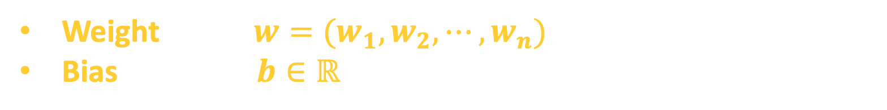
Definitions & Principles
Logistic Regression
We set $0.5$ as the dividing line for the sigmoid function’s output:
What we needs to optimize:
Weight $w=(w_{1}, w_{2}, ⋯, w_{n})$
Bias $b∈ℝ$
Notes:
To conclude, Logistic Regression thinks taken the linear combination of weights and the bias as the Sigmoid function’s input, the result happens to be the probability that this datapoint belongs to one certain type.
To make life easier, the data point is classified as the first category if the result is less than $0.5$. Otherwise, it will be categorized into the other type.
However, there are two parameters which needs to be determined in order to calculate the probability: weight, and bias.
To optimize them, we needs the help of a loss function and one optimization method:
Cross-Entropy Loss Function & Gradient Descendent (Ascendent).
Then, we are going to explain and derive the cross-entropy error function from the perspective of probability.

Slide 11

Definitions & Principles
Cross-Entropy Loss Function
Binary Logistic Regression’s loss function is Cross-Entropy Loss Function, with the form of:
Now we start to derive it from scratch.
Assume
Then we have
(1)
(2)
Notes:
The cross-entropy loss function looks pretty complex, but it's consisted by simple parts and backed up by simple principles.
To gain a deeper understanding of it instead of memorizing this complex formula, we will derive the loss function from the perspective of maximum likelihood estimation and explain why it reflects the accuracy of our model.
Remember that logistic regression is a binary classification algorithm, so it can only classify datapoints into two categories. Based on the algorithm’s assumption, we are safe to think the probability distribution that the datapoint belongs to either type follows Bernoulli distribution.
Then we have the following equation (2) describing the probability that y equals to 1 or 0, given value x, w and b.

Slide 12
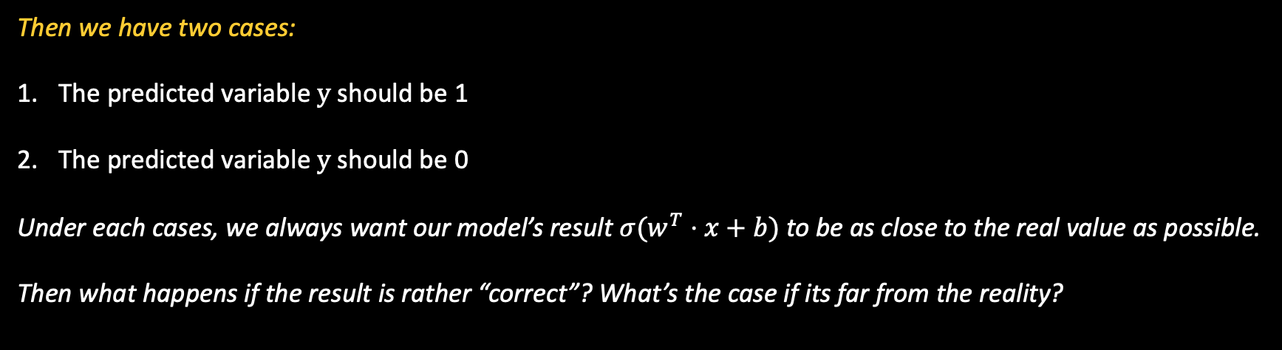
Definitions & Principles
Cross-Entropy Loss Function
From equation
Take its logarithm, then we get…
Then we have two cases:
The predicted variable $y$ should be 1
The predicted variable $y$ should be 0
Under each cases, we always want our model’s result $σ(w^{T}⋅x+b)$ to be as close to the real value as possible.
Then what happens if the result is rather “correct”? What’s the case if its far from the reality?
Notes:
Next, we strip the right-hand side formula from the equation and take its logarithm.
Then we will explain how this formula reflects the accuracy of our model:
In our prediction, there are only two possibilities. The first one is, given parameters x, the real value y of this datapoint should be 1, or it should be 0.
And clearly, since the omega thing reflect the probability that y equals to 1, if in reality, y should be 1, then we hope the omega thing had better be as close to 1 as possible, and the same goes to the case that if y should be 0.
Then we are going to discuss 4 separate cases to see what happens when our prediction is rather close to the reality, and what happens when it’s far from the truth.

Slide 13
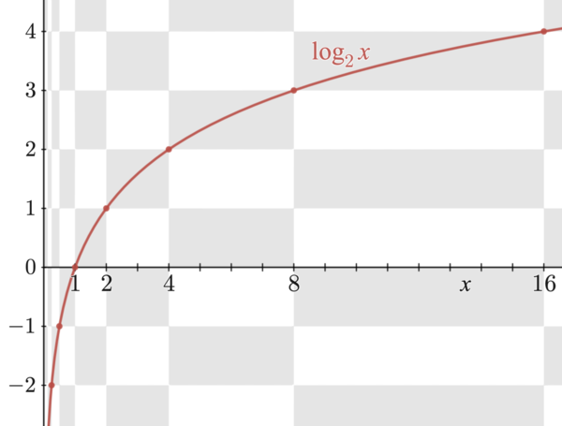
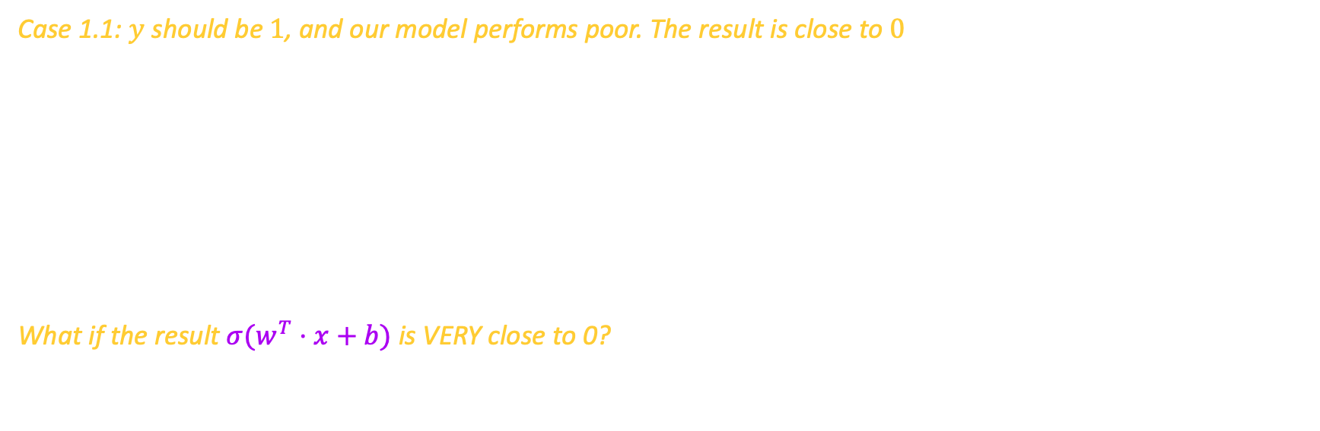

Definitions & Principles
Cross-Entropy Loss Function
Case 1.1: $y$ should be $1$, and our model performs poor. The result is close to $0$
What if the result $σ(w^{T}⋅x+b)$ is VERY close to 0?
…Then its logarithm will be close to $−∞$.
It’s a HUGE punishment from the loss function.
Notes:
We first consider the case that y should be 1. then we can simplify the equation to ditch its second part. Since y should be 1, the equation
Then can be further simplified to only contain the logarithm of the omega thing.
With our knowledge of logarithm funtion, we can see that if our model performs poor, i.e. its result is far from the truth, then the result of this formula is a huge negative value, which can be seen as the “punishment” from the loss function.

Slide 14

Definitions & Principles
Cross-Entropy Loss Function
Case 1.2: $y$ should be $1$, but our model performs great. The result is close to $1$
What if the result $σ(w^{T}⋅x+b)$ is VERY close to 1?
…Then its logarithm will be close to 0.
This time, things seems to be working well!
Notes:
However, if our model has a rather good performance, then the value of the equation will be close to 0, i.e. we got almost no punishment from it. and the closer our result is to 1, the closer the value of the equation will be.
So we’ve seen that if y’s true value should be 1, this equation has done a good job evaluating the accuracy of our model. So what about the case that y should be 0?

Slide 15
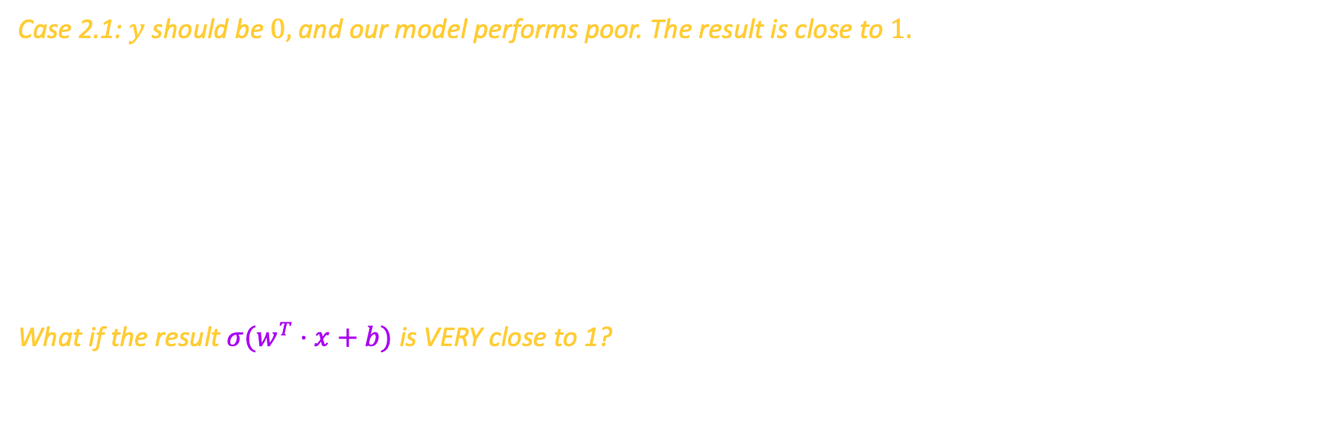
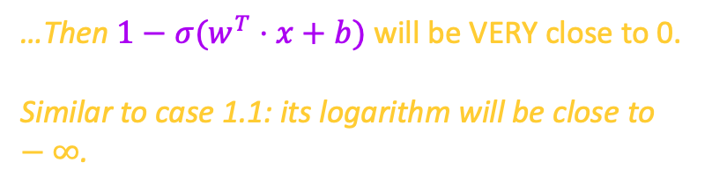
Definitions & Principles
Cross-Entropy Loss Function
Case 2.1: $y$ should be $0,$and our model performs poor. The result is close to $1.$
What if the result $σ(w^{T}⋅x+b)$ is VERY close to 1?
…Then $1−σ(w^{T}⋅x+b)$ will be VERY close to 0.
Similar to case 1.1: its logarithm will be close to $−∞$.
Notes:
It turns out that everything is quite similar to the case when y should be 1. in this particular case, 1-y is simplified to 1 since y's real value is 0, and if we take (1-sigma) as a whole, it’s identical to case 1.1.

Slide 16
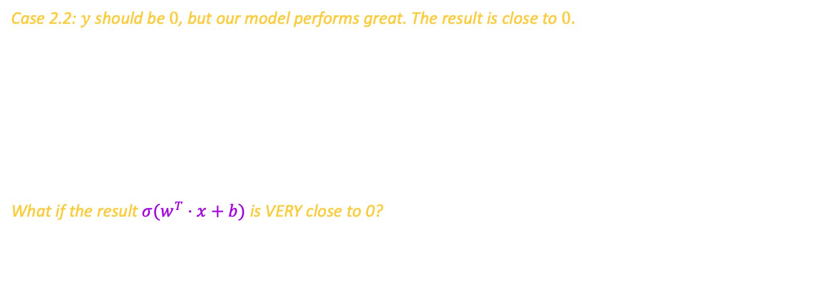
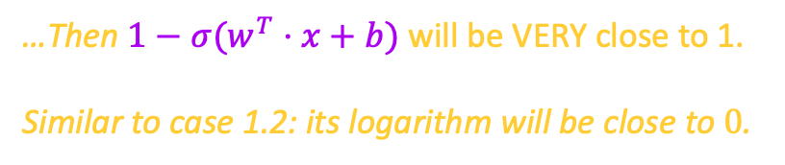
Definitions & Principles
Cross-Entropy Loss Function
Case 2.2: $y$ should be $0$, but our model performs great. The result is close to $0.$
What if the result $σ(w^{T}⋅x+b)$ is VERY close to 0?
…Then $1−σ(w^{T}⋅x+b)$ will be VERY close to 1.
Similar to case 1.2: its logarithm will be close to $0$.
Notes:
Similarly, the result is close to case 1.2. we can see that no matter the real value of y should be 1 or 0, the equation’s value will be 0 if and only if the prediction is 100% correct, and the more inaccurate our prediction is, the closer this equation’s value will be to -\infty.
Formally, this equation has a name. it’s called the logarithm likelihood function of each datapoint. So what about the entire dataset? How could we evaluate our model’s performance over the entire set?

Slide 17
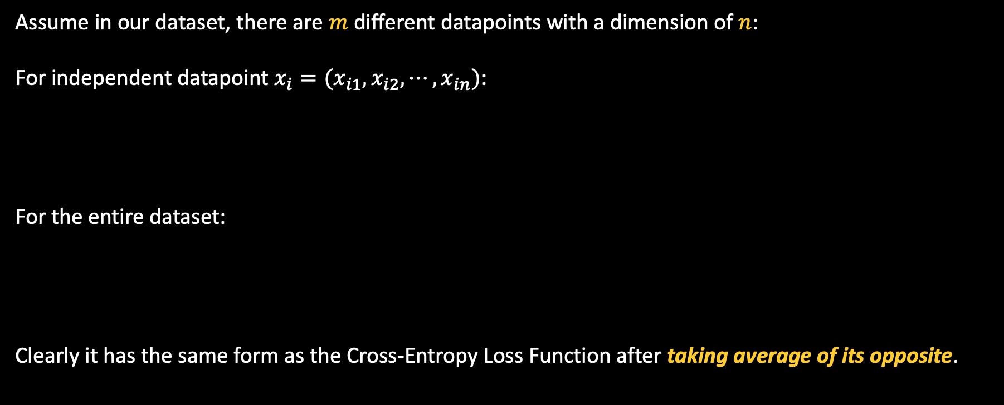
Definitions & Principles
Cross-Entropy Loss Function
Assume in our dataset, there are $m$ different datapoints with a dimension of $n$:
For independent datapoint $x_{i}=(x_{i1},x_{i2},⋯, x_{in})$:
For the entire dataset:
Clearly it has the same form as the Cross-Entropy Loss Function after taking average of its opposite.
…And it reflects how close our model’s prediction is to the real value.
Notes:
It turns out to be pretty simple. By summing every datapoint’s logarithm likelihood function, we get the evaluation of our model’s overall accuracy over the entire dataset.
Clearly the value of this formula reveals how inaccurate our model is: the more our model is accurate, the larger it will be. (close to 0 )
Finally, take an average of the sum, and pick the opposite of it, we then got the cross-entropy loss function.
It explains why we take the opposite in transforming this formula into the Cross-Entropy Loss function. It’s because we are going to apply Gradient Descendent to find the optimal parameter $w$ (weights) and $b$ (bias) which minimizes, instead of maximize it.

Slide 18
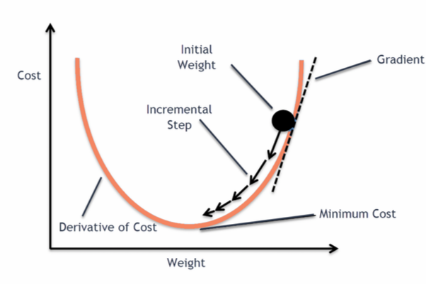
Fitting Regression Parameters
Gradient Descendent Method
Gradient Descendent is an optimization method which finds the local minimum of one function.
The principle of Gradient Descendent Method is very similar to mountain climbing.
Gradient Descendent Method is used in many different cases.
We have discussed its principle and implementation in the past workshop.
Notes:
Logistic Regression usually use Gradient Descendent Method to optimize the loss function in order to get the optimal value of parameters.
In applying Gradient Descendent algorithm, just like mountain climbing, we keep going “deeper”, moving to the negative of the gradient. If we “go higher”, approaching the positive of the gradient (moving towards the gradient), then we will approach “the top of the mountain”, a local maximum of the function and the procedure is called Gradient Ascent.
Gradient Descendent Method is widely used in Machine Learning. It’s also used in SGD(Stochastic Gradient Descendent) Methods.

Slide 19
Before Showcase
Notes:
Next, before entering the showcase, we’ll going to discuss two more definitions: Confusion Matrix, and Decision Boundry.

Slide 20
Additional Definitions
Confusion Matrix
Actual values
The confusion matrix is a handy tool to visualize one
model’s performance on a given test dataset.
It provides more information than classification accuracy:
Case1: when your data has more than 2 classes, how do
you know whether all classes are being predicted
equally well, or not?
Case2: when your data has an UNEVEN number of classes,
how do you check if your model just always predict
the most common class value to get a high accuracy?
…digits (classification accuracy) can’t help us, we need matrices.
TP:
Predicted = Positive
Reality = Positive
FP:
Predicted = positive
Reality = Negative
Predicted Values
FN:
Predicted = Negative
Reality = Positive
TN:
Predicted = Negative
Reality = Negative
Def of Confusion Matrix (2 classes)
Notes:
A confusion matrix is a technique for summarizing the performance of a classification algorithm. It can be visualized as a block-like chart, which reveals the number of datapoints which are correctly/incorrectly labelled as each categories.
So you may have one question: In optimization, the only thing we care is classification accuracy, and every single effort we take is to maximize it. Isn’t classification accuracy capable of describing the characteristic of our model’s accuracy?
It turns out that this single value hides many valuable and crucial information from us. It can be misleading if you have an unequal number of observations in each class or if you have more than two classes in your dataset.
Calculating a confusion matrix can give you a better idea of what your classification model is getting right and what types of errors it is making.

Slide 21


Additional Definitions
Confusion Matrix
Case1: when your data has more than 2 classes, how do you know whether
all classes are being predicted equally well, or not?
Predicted Values
Prediction Accuracy of each category
Warning:
to make alignment easier, I’ve transposed the confusion matrix in this slide!
TP:
Predicted = Positive
Reality = Positive
FN:
Predicted = Negative
Reality = Positive
$$\frac{TP}{TP+FP}$$
Actual Values
FP:
Predicted = positive
Reality = Negative
TN:
Predicted = Negative
Reality = Negative
$$\frac{TN}{TN+FN}$$
Notes:
For case 1, we can utilize confusion matrix to evaluate the problem as follows:
Confusion matrix’s each column represents for one given category, how many datapoints are classified correctly, and how many points are categorized to other types respectively. Therefore, by extracting confusion matrix’s each column, which is each row of this transposed matrix, we can calculate the prediction accuracy of each category. Then we can compare them to check if our model have a particularly high or low accuracy on certain types.

Slide 22


Additional Definitions
Confusion Matrix
Case2: when your data has an UNEVEN number of classes, how do you check if your
model just always predict the most common class value to get a high accuracy?
Actual values
Total number of datapoints classified to certain type
TP:
Predicted = Positive
Reality = Positive
FP:
Predicted = positive
Reality = Negative
$$n_{1}$$
Predicted Values
FN:
Predicted = Negative
Reality = Positive
TN:
Predicted = Negative
Reality = Negative
$$n_{2}$$
Notes:
For case 2, we can utilize confusion matrix to evaluate the problem as follows:
The matrix in this slide is now the correct form of confusion matrix. Its each row represents for one given category, how many datapoints are classified as this type. Therefore, by extracting each row, we can evaluate the distribution of our model’s result. Then we can see if our model has any “preference” when making classifications.

Slide 23
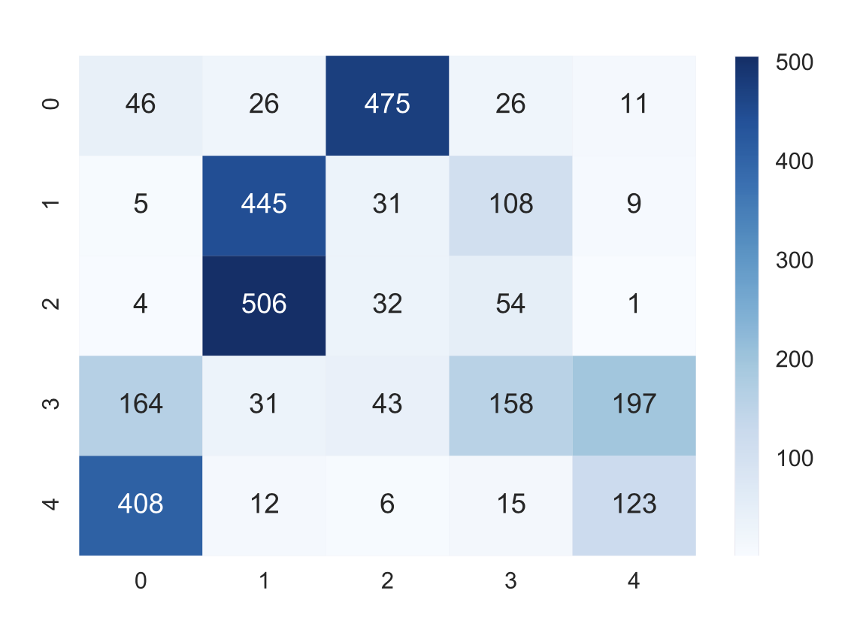
Additional Definitions
Confusion Matrix
For more complex classification problems:
We can extend the dimension of confusion matrix to
satisfy our needs:
Actual values
Predicted = Class1
Reality = Class3
Predicted = Class1
Reality = Class1
Predicted = Class1
Reality = Class2
Predicted = Class2
Reality = Class1
Predicted = Class2
Reality = Class3
Predicted Values
Predicted = Class2
Reality = Class2
Predicted = Class3
Reality = Class1
Predicted = Class3
Reality = Class2
Predicted = Class3
Reality = Class3
Confusion Matrix
(3 classes)
Notes:
Similarly, we can further expand the confusion matrix to fit more complex circumstances. It’s still useful even for larger classification problems.

Slide 24
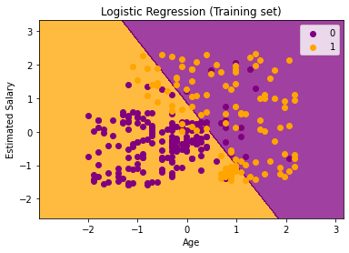
Additional Definitions
Decision Boundary
The decision boundary
of this problem
Decision Boundaries are surfaces which separates the space
containing our datapoints into several regions, each region will
be identified as one certain type.
In other words, decision boundary is the criteria of classifier.
Generally, a decision boundary is a hypersurface that partitions
the vector space containing datapoints into two sets.
In this example, the decision boundary is a straight line separating
The 2-D plane.

Slide 25
Showcase

Slide 26
Conclusion
We discussed the notion of Classification and introduced a methodology which helps you to understand and derive the core principles of understanding classification algorithms.
2. We have seen the full picture that how Logistic Regression works.
Logistic Regression Classification is based on assuming
Sigmoid Function is used to convert the linear combination into a probability value.
Cross Entropy Loss function is essentially the same as MLE.
Gradient Descendent Method is used to optimize weights and bias of the model.
3. We showed how to train a Logistic Regression model using Python ML Libraries and visualize it.
Confusion Matrix is a tool of revealing the Correction & Error rate of one model.
Decision Boundary is a hyperplane which divides the space into two parts, being the key component in classifying different datapoints.

Slide 27
Some More Problems…
1. Why do we choose Cross Entropy Loss function but not the commonly-used MSE?
2. How to explain the Cross Entropy Loss function from the informatics’ perspective?
3. Is there any space for us to further optimize Gradient Descendent Method?
4. Is Logistic Regression suitable in any circumstances? What’s its advantage and its drawback?
5. How to get a deeper understanding of other prevalent classification methods structurally?
🤔

Slide 28
Thanks for Listening!
(Feel free to ask any questions as long as I’m able to answer it XD)

Slide 29
Reference
https://en.wikipedia.org/wiki/Logistic_regression
https://www.zhihu.com/question/47744216/answer/1630238542
https://www.zhihu.com/question/65288314/answer/849294209
https://www.cnblogs.com/smartwhite/p/9109815.html
https://towardsdatascience.com/gradient-descent-algorithm-and-its-variants-10f652806a3
https://blog.clairvoyantsoft.com/the-ascent-of-gradient-descent-23356390836f
https://www.marktechpost.com/2021/02/12/logistic-regression-with-a-real-world-example-in-python/
https://machinelearningmastery.com/confusion-matrix-machine-learning/
https://www.kaggle.com/akram24/social-network-ads
https://towardsdatascience.com/logistic-regression-and-decision-boundary-eab6e00c1e8
Probabilistic Machine Learning: An introduction, Kevin P. Murphy
Python Machine Learning, Sebastian Raschka

